Slide 1
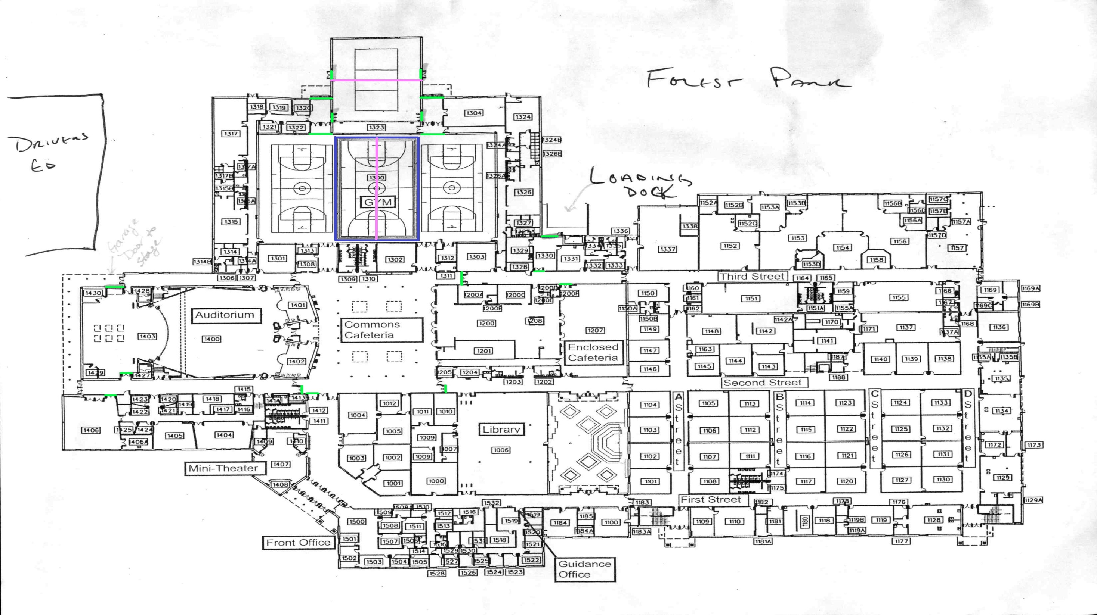
Unit Check In
Unit Holding Area
Dining
Floor Folding
Main Gym
Prop Storage
Spectator & Judge Seating
Performer Seating
Spectator Entrance to School
10. Spectator Entrance to Gym
11. Spectator’s Restrooms
12. Judges Hospitality & Critique
13. Equipment Truck Parking & Loading
14. Spectator Parking
15. Bus Parking
Performer’s Restrooms/Dressing Rooms
AIA Staff and Judge’s Restroom
Concessions Stand
6
Driver’s
Ed Lot
13
7
5
8
18
10
11
Tab
14
1
2
3
4
16
16
17
17
12
11
9
Forest Park High School
General Map
15

